Slide 1
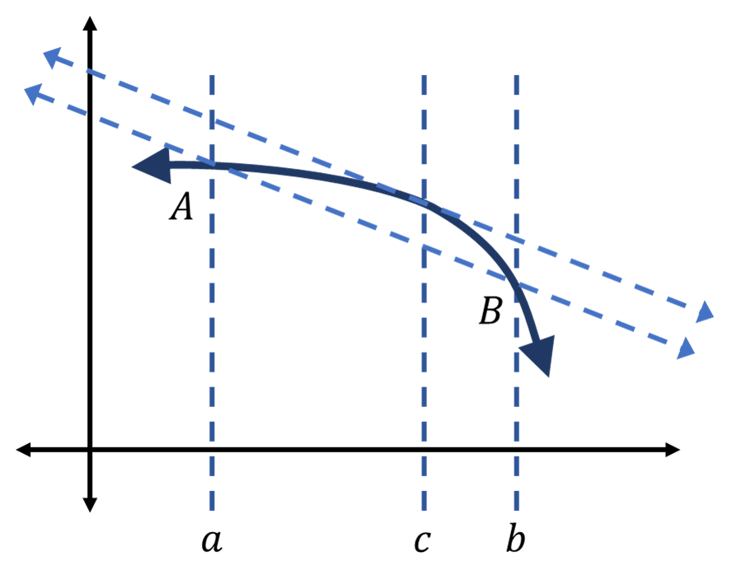

Slide 2



$$a$$
$$c$$
$$b$$

Slide 3
$$a$$
$$c$$
$$b$$

Slide 4
$$a$$
$$c$$
$$b$$

Slide 5



$$A$$
$$B$$
$$a$$
$$c$$
$$b$$

